Slide 1
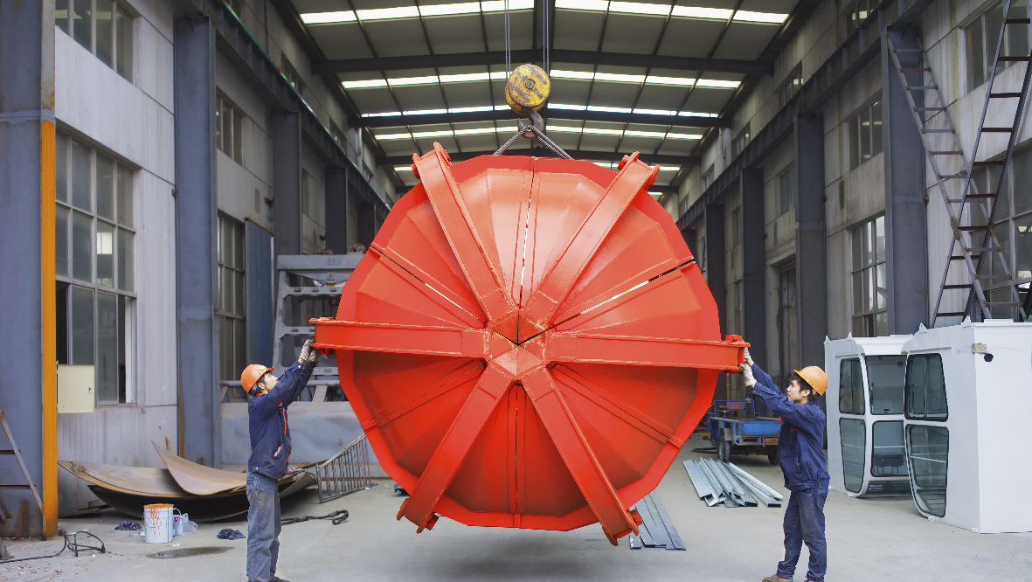
Materials and Methods in interiors
CONSTRUCTION MATERIAL

Slide 2
CONSTRUCTION MATERIAL
UNIT - 1

Slide 3
Introduction to Building Materials
Building Materials and Their Importance in Interior Design:
Building materials: Natural or manufactured substances used in construction of buildings and interior spaces
In interiors, materials affect:
Durability & safety
Aesthetics & comfort
Cost & sustainability
Factors Affecting Selection of Materials:
Strength & Durability – Ability to withstand loads, weathering, and usage.
Cost & Availability – Locally available and affordable materials are preferable.
Workability – Ease of cutting, shaping, fixing, or polishing.
Aesthetics – Texture, color, pattern, and finish.
Maintenance – Long-term care required.
Sustainability – Environmental impact, recyclability, energy efficiency.
Common Building Materials:
Bricks, Stones, Cement, Mortar, Reinforced Cement Concrete (R.C.C) Metals, Plastics.

Slide 4
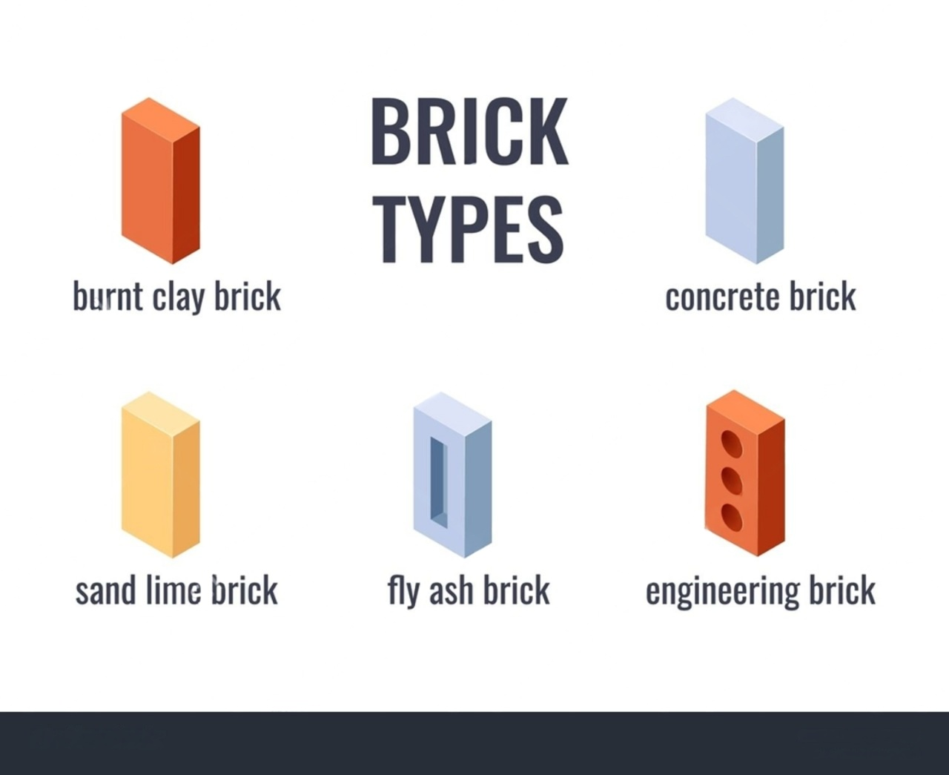
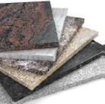
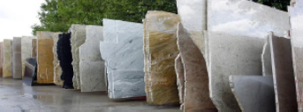
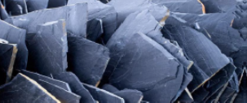
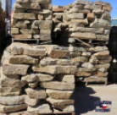
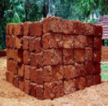
Bricks & Stones
Bricks
Stones
Definition: Small, rectangular artificial clay blocks, burnt in kilns
Types: Burnt clay (1st–3rd class), fly ash, hollow, fire bricks, concrete blocks, engineered bricks
Definition: Natural material quarried from earth
Common Stones
Granite – hard, polished; floors, kitchen tops
Marble – smooth, decorative; floors, interiors, sculptures
Sandstone – porous; cladding, walls
Slate – roofing, flooring, tiles
Laterite – walls (region-specific)
Good Brick Properties
Uniform color, shape, sharp edges
Water absorption ≤ 20% by weight
Should not break when dropped from 1 m
Good Stone Properties
Granite
Marble
Pros
High crushing strength (> 1000 kg/cm²)
Durable, non-porous, weather-resistant
Durable, cheap, easily available
Good compressive strength (3.5–10 N/mm²)
Fire resistant, good sound insulation
Pros
Very durable, strong, fireproof
Polished surfaces are visually rich
Slate
Cons
Cons
Absorbs water → dampness
Brittle in tension, needs mortar
Heavy → costlier foundations, difficult transport
Expensive; needs skilled cutting/polishing
Sandstone
Laterite

Slide 5
Cement & Mortar
Cement
Mortar
Definition: Fine binding powder (Portland cement, 1824)
Composition: Lime, silica, alumina, iron oxide, gypsum
Definition: Binder (cement/lime/mud) + sand + water
Types
Types
OPC – general construction
PPC – more eco-friendly, good for plaster
Rapid hardening – quick construction
White – decorative works, tiles, flooring
Cement mortar – strong; brickwork, plaster
Lime mortar – soft; heritage, restoration
Mud mortar – eco-friendly; temporary, low-cost
Pros
Key Data
Bonds units, provides uniform bed
Increases watertightness
Also used for finishing (plaster, pointing)
Initial setting: ~30 min
Final setting: ~10 hours
Pros
Cons
High compressive strength
Versatile: concrete, mortar, plaster, tiles
Factory-made, uniform quality, fire resistant
Low tensile strength
Cracks if not cured properly
Cons
Cons
Costlier than lime
Generates heat → shrinkage cracks possible
Needs proper curing (7–14 days)
Heavy → costlier foundations, difficult transport
Expensive; needs skilled cutting/polishing

Slide 6
R.C.C. (Reinforced Cement Concrete)
Definition: Concrete (cement + sand + coarse aggregate + water) reinforced with steel bars
Purpose: Concrete resists compression; steel resists tension
Uses
Beams, slabs, columns, foundations
Staircases, frames of high rise buildings
Structural elements in most modern buildings
Cons
More expensive than plain concrete
Requires skilled labor and proper detailing
Needs curing for adequate strength
Pros
Can be cast into any shape/form
Strong in both compression & tension (as a composite)
Durable and weather resistant
Properties
High compressive strength
Fire resistant
Good bond between steel and concrete

Slide 7
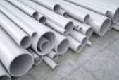
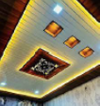

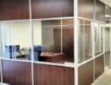

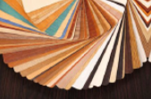
Metals & Plastics in Interiors
Metals
Plastics
01
Common Metals
Steel – structure, reinforcement, stairs, furniture
Aluminium – lightweight windows, partitions, frames
Copper – wiring, roofing, decor
Brass & bronze – decorative railings, hardware
Iron – grills, gates, railings
04
Types
Thermoplastics – PVC, acrylic, polycarbonate (re-mouldable)
Thermosets – bakelite, laminates (non-remouldable)
PVC
02
Pros
High tensile strength
Ductile, malleable, recyclable
Sleek, modern appearance
05
Pros
Lightweight, easy to transport and install
Waterproof, termite-proof
Wide range of colors, textures, finishes
Generally cost-effective
Polycarbonate
Bakelite
03
Cons
Corrosion (iron, steel need paint/coating)
Expensive
High thermal conductivity (feels hot/cold)
06
Cons
Not eco-friendly (mostly non-biodegradable)
Lower strength than metals/concrete
Softens or deforms at high temperatures
Acrylic
Laminates

Slide 8
Wood & Timber
UNIT - 2

Slide 9

Manufactured Wood
Manufactured (Industrial) Wood is a wide range of composite wood products used in construction and furniture.
Made by pressing wood fibers, chips, strands or veneers together with adhesives under heat and pressure.
Common types: plywood, blockboard, fiberboard (MDF, LDF, HDF), OSB, veneer, laminated wood.
Aim: create materials with more uniform, stable and sometimes stronger properties than natural solid wood.
Produced in many forms and sizes depending on components used and the intended application.
9

Slide 10
Plywood & Blockboard
Plywood
Built from thin wood veneers glued in cross layers to form strong panels.
Graded A, B, C, D; Grade A has very high strength and good appearance.
Uses: flooring, furniture, roofs, partitions, wall panels.
Pros: natural wood grain, good water & compression resistance, easy to cut, glue, paint; resistant to insects.
Cons: not all types suit outdoor use; quality depends on veneers and glue; relatively expensive.
Blockboard
A type of plywood using a softwood block core sandwiched between veneers.
Fabricated from softwood + hardwood, giving strength, stability and a smooth surface.
Used for tables, cabinets, wardrobes, doors, wall panels, ceilings, etc.
Pros: strong, lightweight, smooth, easy to finish; many thicknesses; less warping.
Cons: usually less durable than plywood; not ideal for outdoors or high humidity areas.
10

Slide 11
Plywood & Blockboard
Standard Blockboard
Softwood block core with veneers.
For general purpose furniture and interior work in homes and offices.
Marine Blockboard
Treated for moisture resistance; withstands water and humidity.
Used in kitchens, bathrooms, damp areas.
Fire Retardant Blockboard
Treated with special fire retardant chemicals.
Used where fire safety is critical: public buildings, industries.
Decorative Blockboard
Faced with high quality decorative veneers.
For premium furniture and interiors where aesthetics are important.
11

Slide 12
Fiberboard & OSB
Fiberboard (MDF, LDF, HDF)
Made from wood fibers + resin, pressed at high temperature and pressure.
Denser and stronger than particleboard; good abrasion resistance.
Types:
MDF – medium density, stronger than LDF, less than HDF; can withstand some weather change.
LDF – low density, similar to particleboard.
HDF – high density, harder and more durable than MDF.
Popular for furniture, partitions, sound proofing, thermal insulation.
Pros: smooth, uniform, no voids; ideal for paint or wallpaper; cheaper than plywood; eco friendly use of fibers.
Cons: generally not moisture resistant; less durable than plywood; can be slower to nail and install.
Oriented Strand Board (OSB)
Engineered panel of oriented wood strands bonded with resin in cross layers.
Used for wall framing, floor/roof sheathing, packaging, DIY and some furniture.
Pros: cheaper than plywood; good strength and load bearing; easy to cut and drill.
Cons: can swell and warp in humidity; usually not as durable as plywood for structural work.
12

Slide 13
Veneer & Laminated Wood
Veneer
Thin slices of natural wood glued onto plywood, MDF, particleboard or solid wood.
Gives the appearance of expensive solid timber at lower cost.
Uses: furniture, doors, decorative panels, pianos, guitars, other instruments.
Pros: allows use of rare woods; wide range of colors and grains; many patterns and styles possible.
Cons: thin layer is easily scratched or damaged; repairs are harder than with solid wood.
Laminated Wood
Built by parallel gluing lumber boards (or veneers) into larger members: beams, arches, furniture parts, sporting goods.
Advantages:
Can make large sizes and curved shapes not possible with solid wood.
Boards can be well dried; defects like knots can be cut out.
High grade wood placed only where needed; low grade and small pieces used elsewhere → less waste.
Members can be designed exactly for the required strength.
13

